Slide 1

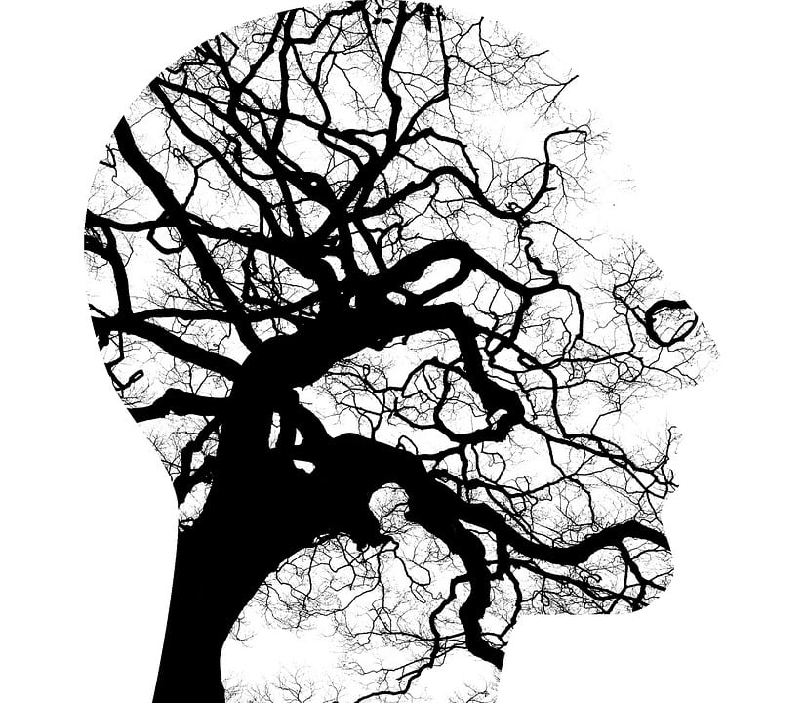
MENTAL HEALTH prEDICTION
Leveraging Machine Learning to Predict Mental Health Disorders
FATHIMA RIFA
Data Science

Slide 2

objective
To analyze psychological and demographic data to predict the likelihood of mental health disorders using machine learning techniques, enabling early detection and awareness.
OVERVIEW STEPS
Dataset Creation
Data preprocessing
Training the dataset
Creating various supervised machine learning model
Selecting the best performing model
Deploying the model using Streamlit

Slide 3
CHOOSING A DATASET
The dataset was created using Python and Health Research.
The dataset includes various features of both Psychological and Demographic data.
These features are used to analyze and classify whether a person need help or not.
All features were combined into a clean dataframe . Finally, the dataset was saved as a CSV file for further analysis and model training.
Brief Description:
The dataset includes features such as age, gender, city, education level, income rate, depression score, anxiety score, stress score, suicide risk score and treatment access.
Dataset includes 50,000 rows and 13 columns.

Slide 4
FEATURES
targets
Gender
Age
City
Education Level
Income Rate
Depression Score
Anxiety Score
Stress Score
Suicide Risk Score
Treatment Access
Diagnosed Disorder = Yes
Diagnosed Disorder = No

Slide 5
UNDERSTANDING THE PROBLEM
PROBLEM DEFINITION
Lack of early identification of mental health disorders leads to delayed treatment and worsening mental health outcomes. Many individuals do not have access to early screening tools ,resulting in untreated psychological conditions. The goal is to predict whether a person is diagnosed with a mental health disorder using available data. The problem is modeled as a binary classification task. Multiple machine learning models are trained and evaluated to find the best-performing model.
IMPORTANCE
Accurate mental health prediction helps in early interventions, reduces long-term risks and promotes overall well-being and productivity. Demonstrates the effective use of machine learning in healthcare applications.

Slide 6
DATA PREPROCESSING
Rename : Renamed the columns name of rural/urban and Education level.
Encoding Categorical Variables : Convert Categorical data (Eg :- gender, city, treatment access)into numeric formats using techniques like label encoding. Mapping performed in education.
Scaling Numerical Features : Normalize or standardize numerical features to ensure consistent scale.
Feature Selection : Select relevant Features by analyzing correlations and removing irrelevant or redundant data.
Data splitting: Dividing the data into training, Hyperparameter tuning and test sets to evaluate model performance.

Slide 7
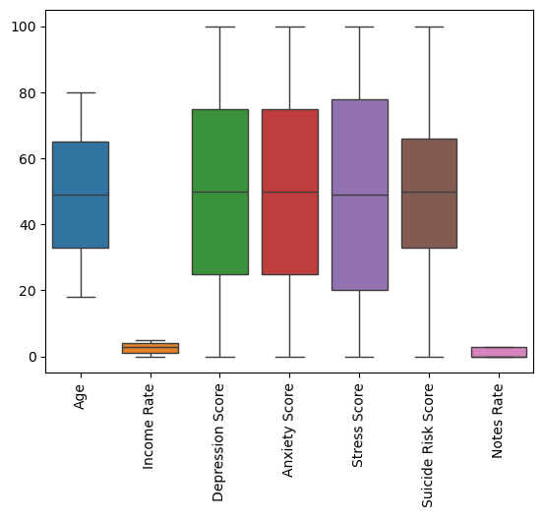
Exploratory data analytics (eda)
Visualization
Boxplots to detect outliers and variations

Slide 8
Summary statistics
 | Count | Mean | std | min | 25% | 50% | 75% | max
Age | 50000.0 | 49.02782 | 18.170405 | 18.0 | 33.0 | 49.0 | 65.0 | 80.0
Income Rate | 50000.0 | 2.49842 | 1.708009 | 0.0 | 1.0 | 3.0 | 4.0 | 5.0
Depression Score | 50000.0 | 50.06234 | 29.106625 | 0.0 | 25.0 | 50.0 | 75.0 | 100.0
Anxiety Score | 50000.0 | 49.89174 | 29.167352 | 0.0 | 25.0 | 50.0 | 75.0 | 100.0
Stress Score | 50000.0 | 49.49934 | 32.865281 | 0.0 | 20.0 | 49.0 | 78.0 | 100.0
Suicide Risk Score | 50000.0 | 49.47904 | 22.695256 | 0.0 | 33.0 | 50.0 | 66.0 | 100.0
Notes Rate | 50000.0 | 1.22802 | 1.347228 | 0.0 | 0.0 | 0.0 | 3.0 | 3.0

Slide 9
DATA ANALYSIS TECHNIQUES
Techniques Used:
Descriptive Statistics
Data Visualization
Modelling
Classification Models:
Model Choice: Implemented models include Logistics Regression , Decision Tree, Random Forest, KNN, Support Vector Machine, Naïve Bayes, Boosting.
Training and Testing: Data splits into training and test sets for model validation.

Slide 10
MODEL | TEST ACCURACY | TRAIN ACCURACY
Logistics Regression | 98.144 | 98.069333
Decision tree | 96.328 | 100.000000
Random Forest | 97.040 | 99.658667
K Neighbors Classifier | 94.088 | 97.269333
Support Vector Mechanism | 98.024 | 98.210667
Naïve Bayes (Gaussian NB) | 96.408 | 96.541333
Ada boost | 94.008 | 93.944000
Gradient boost | 96.408 | 96.541333
XGB | 97.752 | 99.517333
The selected model is Logistics Regression.

Slide 11
Hyperparameter Tuning
Hyperparameter tuning is the process of selecting the optimal hyperparameters for a machine learning model to improve its performance and generalization ability. Hyperparameters are configuration settings set before training begins and control various aspects of the model’s learning.
GridSearchCV
It is a hyperparameter tuning technique used to find the best combination of hyperparameters for a machine learning model.
Evaluate the Results:
Best model: Logistics Regression
Best parameters: 'C’: [10]

Slide 12
Evaluated Matrices Result
Accuracy score: Overall proportion of correctly classified instances.
Accuracy scores = 0.9812
Weighted Average: Average of precision, recall, and F1 score, weighted by the number of true instances of each class.
Precision: 0.98
Recall: 0.98
F1 Score: 0.98

Slide 13
INSIGHTS AND RECOMMENDATIONS
KEY FINDINGS:
Flawless Metrics: The model demonstrates perfect accuracy, precision, and recall scores .
Logistics Regression handled complex data patterns effectively.
Scaling significantly improved performance.
Psychological score features had strong predictive power.
Recommendations:
Use more real-world clinical datasets.
Perform periodic model retraining.
Test model on external validation datasets.

Slide 14
SOLUTION IMPLEMENTATION
Implementation Steps
Deploy Logistics Regression model using Streamlit.
Integrate into mental health support systems.
Monitor model performance regularly.
Impact:
Faster mental health screening.
Improved early decision-making.
Scalable and efficient prediction system.
Cost and Time Efficiency.

Slide 15
CONCLUSION
The project successfully demonstrates the application of machine learning techniques for predicting mental health disorders using structured data. It developed a mental health prediction system using the Logistics Regression algorithm. The model demonstrated high performance, reliability and consistency, making it suitable for real-world mental health risk prediction. The result indicate that machine learning can serve as a powerful decision-support-tool for early mental health risk identification. While the system does not replace medical professionals, it provides valuable insights that can assist in early screening, awareness and timely intervention.
Overall, this project highlights the potential of data- driven, ethical and scalable solutions in the healthcare domain, especially in addressing mental health challenges efficiently and responsibly.

Slide 16
THANK YOU
HOPE YOU ALL TAKE CARE OF YOUR MENTAL HEALTH

